Slide 1
Equitable Services to English Learners in Nonpublic Schools
Title III Consortium Meeting
September 17, 2019

Slide 2
Today’s Agenda
Introductions
Providing Equitable Services
Identifying English Learners
Complying with Title III
Questions
Notes:
[When presenting, this slide requires multiple clicks to reveal each element]

Slide 3
Nonpublic Ombudsman Under ESSA
“Ombudsman Procedures for Ensuring Equitable Services”
  CCIP Note #403 November 2018

Slide 4
Overview of ESSA Section 8501
SEC. 8501. PARTICIPATION BY PRIVATE SCHOOL CHILDREN AND TEACHERS.
(a) PRIVATE SCHOOL PARTICIPATION-
(1) IN GENERAL- Except as otherwise provided in this Act, to the extent consistent with the number of eligible children in areas served by a State educational agency, local educational agency, educational service agency, consortium of those agencies, or another entity receiving financial assistance under a program specified in subsection (b), who are enrolled in private elementary schools and secondary schools in areas served by such agency, consortium, or entity, the agency, consortium, or entity shall, after timely and meaningful consultation with appropriate private school officials provide to those children and their teachers or other educational personnel, on an equitable basis, special educational services or other benefits that address their needs under the program.

Slide 5
Title IX
Non-Regulatory Guidance
TITLE IX, PART E, UNIFORM PROVISIONS, SUBPART 1—PRIVATE SCHOOLS Equitable Services for Eligible Private School Students, Teachers, and Other Educational Personnel Non-Regulatory Guidance March 2009

Slide 6

Title IX Non-Regulatory Guidance
Notes:
www2.ed.gov/policy/elsec/guid/equitableserguidance.doc

Slide 7
Identification of English Learners
Local education agencies:
1. must ensure private school students are appropriately identified as ELs, and
2. cannot require a nonpublic school to administer an English language proficiency assessment as a condition for the nonpublic school to receive equitable services under Title III.

Slide 8
Nonpublic Data System
FY20 reporting window was year 4 for the system
Reporting occurs from February to May
Report the number of English Learners as of October count week

Slide 9
Nonpublic Data System
Nonpublic officials have the responsibility to begin the process in a timely manner
Public district officials have responsibility to verify counts before marking Public Approved
Public district officials have obligation to consult annually

Slide 10
Title III: Language Instruction for English Instruction
Allowable activities include:
  Supplemental education supports
  Parent engagement supports
  Professional development supports to all teachers who have English learners in their classrooms.

Slide 11


Title III Allowable Activities in the Nonpublic School Setting
Title III supplemental supports
Title I supplemental supports
Core education program

Slide 12
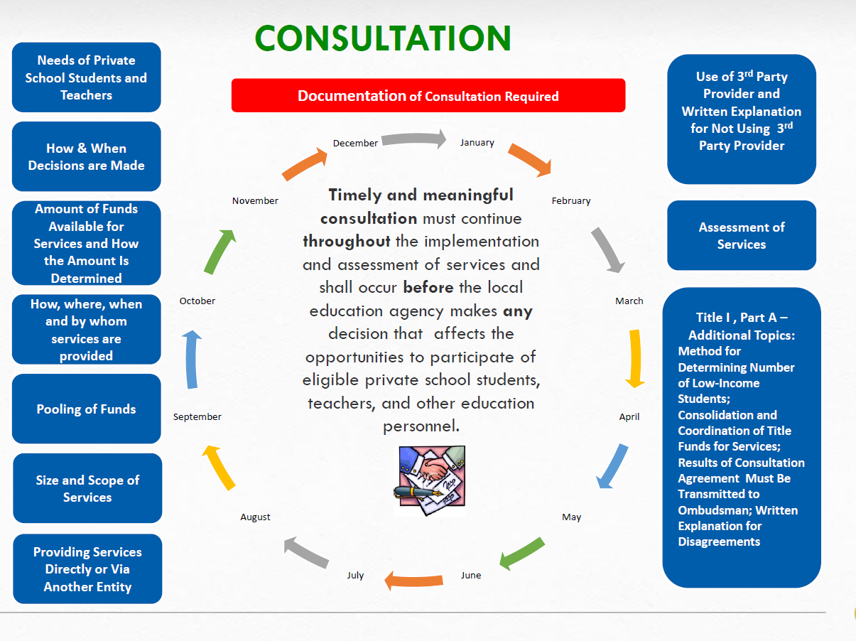

Slide 13
Title III Allowable Activities in the Nonpublic School Setting
• Tutoring for ELs before, during, or after school hours;
• Professional development for private school teachers of ELs;
• Summer school programs to provide English language instruction for ELs;
• Administration of an ELP assessment for identification of ELs and/or for the purpose of evaluating the effectiveness of services, including the provision of test booklets, teacher training, and stipends to teachers to administer assessments; and
• Provision of supplemental instructional materials and supplies. These materials and supplies must be supplemental to what the private school would be required to provide in the absence of the Title III services. These materials and supplies must also be clearly labeled and identified as the LEA’s property, and must be secular, neutral, and non-ideological. The LEA is required to maintain oversight of all materials and supplies purchased with Title III funds.

Slide 14

Title III: Language Instruction for English Instruction
Title III funds may not be used to meet the civil rights obligations a school has to children.
Ensuring English Learner Students Can Participate Meaningfully and Equally in Educational Programs Fact Sheet

Slide 15
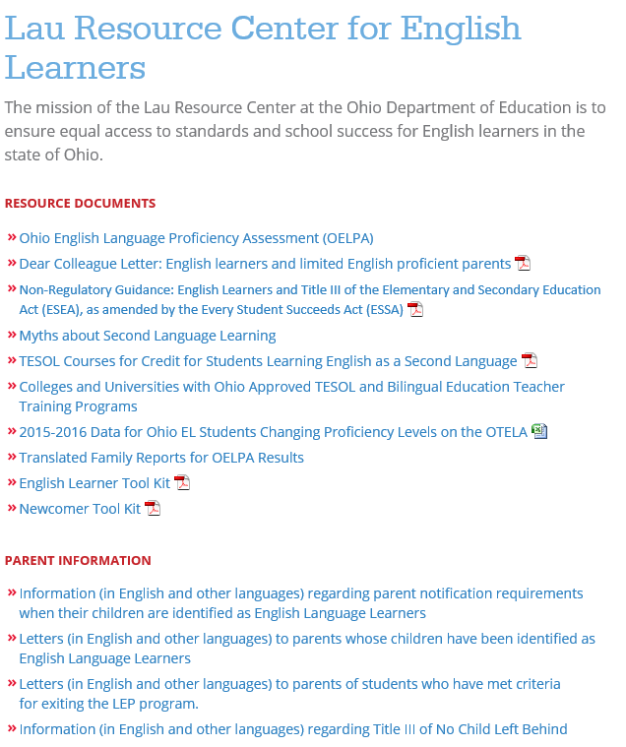
The Lau Resource Center at the Ohio Department of Education

Slide 16
The Lau Resource Center at the Ohio Department of Education
DONNA VILLAREAL
Lau Resource Center for English Learners
614-387-2245
donna.villareal@education.ohio.gov
MATTHEW IMPERATO
Office of Integrated Student Supports
614-387-2250
matthew.imperato@education.ohio.gov
LAU RESOURCE CENTER
614-466-4109
lau@education.ohio.gov

Slide 17

TITLE III, PART A, English Language Acquisition, Language Enhancement, and Academic Achievement, Equitable Services to Private School Students, Teachers, and Other Educational Personnel Non-Regulatory Guidance July 2015
Notes:
TITLE III, PART A, English Language Acquisition, Language Enhancement, and Academic Achievement, Equitable Services to Private School Students, Teachers, and Other Educational Personnel Non-Regulatory Guidance July 2015
https://www2.ed.gov/about/offices/list/oii/nonpublic/titlethree.pdf

Slide 18
Title III Compliance
Evidence of consultation
Evidence of a district process to identify English Learners in the nonpublic setting
Compliance to supplement not supplant provision
Fiscal records in alignment with allowable activities

Slide 19
Equitable Services Timeline
End of School
Evaluation and Carryover Determinations
Summer
Ongoing consultation
February
Begin reporting in NPDS
Start of School
Services begin
Notes:
[When presenting, this slide requires multiple clicks to reveal each element]

Slide 20
“What about…”
Are we required to send the parental notifications as described in Section 3302 to nonpublic families?
  No – but during the consultation process, a discussion should occur regarding how families will be made aware of Title III services.

Slide 21
“What about…”
Does Title III require LEA’s to administer the State annual ELP assessment to children in nonpublic schools?
  No.

Slide 22
“What about…”
May an LEA reimburse a nonpublic school for providing Title III services or materials to nonpublic children or teachers?
  No.

Slide 23

Questions?

Slide 24






@OHEducation

Slide 25

Share your learning community with us!
#MyOhioClassroom
Celebrate educators!
#OhioLovesTeachers

